Slide 1
Agenda
Formalization of data freshness over-engineering concept
Overview of current work on resource sharing in Xen

Slide 2
Data Freshness Over-engineering

Slide 3
Observation:
There are many instances where data is processed through a chain of tasks
We often want this data to have some degree of “freshness”
Task A
Data
Task B
Task C
Freshness Constraint
Why not just consolidate into one task? There may be other uses for task outputs or other
computations they perform, or other reasons to have the tasks separate/modular.

Slide 4
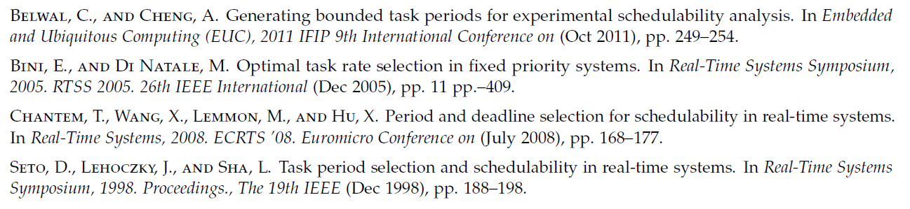
Naïve Approach
Choose input tasks with as small of periods as possible while maintaining schedulability
Guess appropriate values from a range of seemingly reasonable ones and test system safety and efficiency
This is sometimes done in practice!

Slide 5
Goal
(Loose) Problem statement:
“Ensure that data consumed by the final task in a task data-flow chain meets a predetermined freshness guarantee.”
Where “freshness” represents the age of the oldest input, i.e. when the first task in the chain produced the result used in the computation.
Example: Task Y needs to consume speed data produced by task X that is as most 100ms old

Slide 6

Definitions
We use a periodic task set, so given job i of task A:
P_{A} = period of task A
D_{A} = relative deadline to jobs of task A
E_{A} = worst-case execution time
$r_{A}^{i}$ = release time of i^{th} job of task A
$f_{A}^{i}$ = finish time of i^{th} job of task A
Given two tasks A and B, where B wants “fresh” data:
d_{A→B} = [desired] upper bound on data age
$C_{A}\left(r_{B}^{i}\right)$ = most recently completed job of task A before the release of job i of task B

Slide 7
Assumptions
We do not know the nature of the tasks, so we abstract as follows:
Data is published at the end of tasks
Data is consumed at release of tasks
We do not know the scheduler or task priorities
Task set is ultimately schedulable (reason later)
Uniprocessor system

Slide 8

Problem Statement: 2 Task Scenario
We have task A → task B
Given: E_{A}, E_{B}, P_{B}, and d_{A→B}, determine P_{A} so that:
$\left(r_{B}^{i}−f_{A}^{C_{A}\left(r_{B}^{i}\right)}\right)≤d_{A→B}$ for all i
i.e. find the period of task A so that the age of the data consumed by any job of task B is at most d_{A→B}

Slide 9


Maximum Wait / Starvation Scenario
$$f_{A}^{C_{A}\left(r_{B}^{i}\right)}$$
$r_{B}^{i}$ = t+ 2P_{A} – 
Last Job of Task A
Release of Job of Task B
P_{A}
P_{A}
t
t+ P_{A}
t+ 2P_{A}

Slide 10



Two Task Result
$d_{A→B}≤2P_{A}−\text{}−E_{A}$
$d_{A→B}≤2P_{A}−E_{A}$
$P_{A}≤\frac{\left(d_{A→B}+E_{A}\right)}{2}$
$$f_{A}^{C_{A}\left(r_{B}^{i}\right)}$$
Max possible
staleness
$r_{B}^{i}$ = t+2 P_{A}– 
A
A
P_{A}
P_{A}
t
t+ P_{A}
t+2 P_{A}
Underlying Assumption: Final Task Set Must Be Schedulable!

Slide 11

Lemma (From Previous Slide)
To ensure the freshness between two tasks,
Given $E_{A}$ and $d_{A→B}$, set $P_{A}≤\frac{\left(d_{A→B}+E_{A}\right)}{2}$
Notes: doesn’t guarantee schedulability under any particular scheduler and P_{B} is irrelevant.

Slide 12
Three Task Scenario
Now we have tasks A, B, and C
A produces output that B consumes
B produces output that C consumes
Want a freshness bound from for the data from task A to task C

Slide 13

Problem Statement: 3 Task Scenario
A → B → C
$\left(r_{C}^{i}−f_{A}^{C_{A}\left(r_{c}^{i}\right)}\right)≤d_{A→C} for all i$
i.e., the age of the data consumed by C was derived from data produced by A that is at most d_{A→C} old
No constraint on when B is executed between them

Slide 14



Problem Transformation: Enact Local Constraints
$$f_{A}^{C_{A}\left(r_{c}^{i}\right)}$$
d_{A→C} = d_{A→B} + E_{B} + d_{B→C}
By Lemma…
$P_{A}≤\frac{\left(d_{A→B}+E_{A}\right)}{2}$
$P_{B}≤\frac{\left(d_{B→C}+E_{B}\right)}{2}$
d_{A→B}
$$r_{c}^{i}$$
E_{B}
d_{B→C}

Slide 15
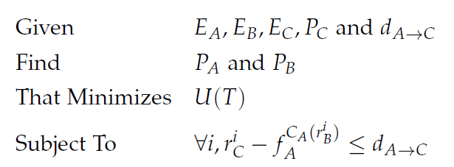
Optimization

Slide 16

Revised Objective
Since we can only choose P_{A} and P_{B}, we can only minimize the contribution to utilization from these two tasks
Revised Objective: Minimize $\left(\frac{E_{A}}{P_{A}}+\frac{E_{B}}{P_{B}}\right)$
Also note: To minimize utilization we want to set periods as large as possible, so the inequality in our Lemma becomes an equality
We use this on the next slide

Slide 17
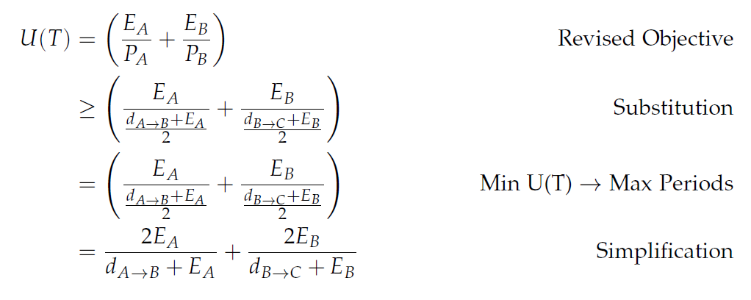
Revised Objective

Slide 18
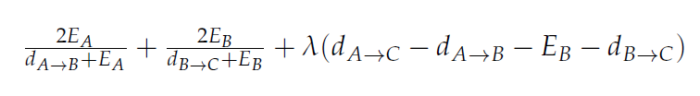
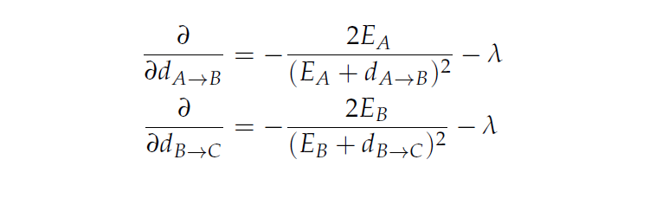
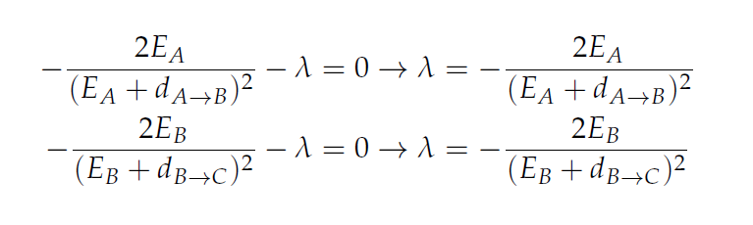
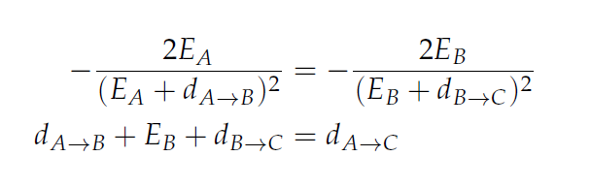
Solution: Using Lagrange Multipliers

Slide 19
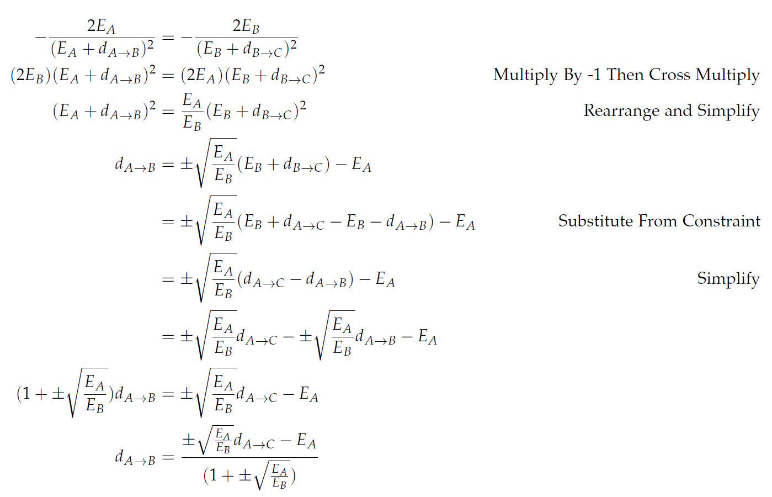

Slide 20
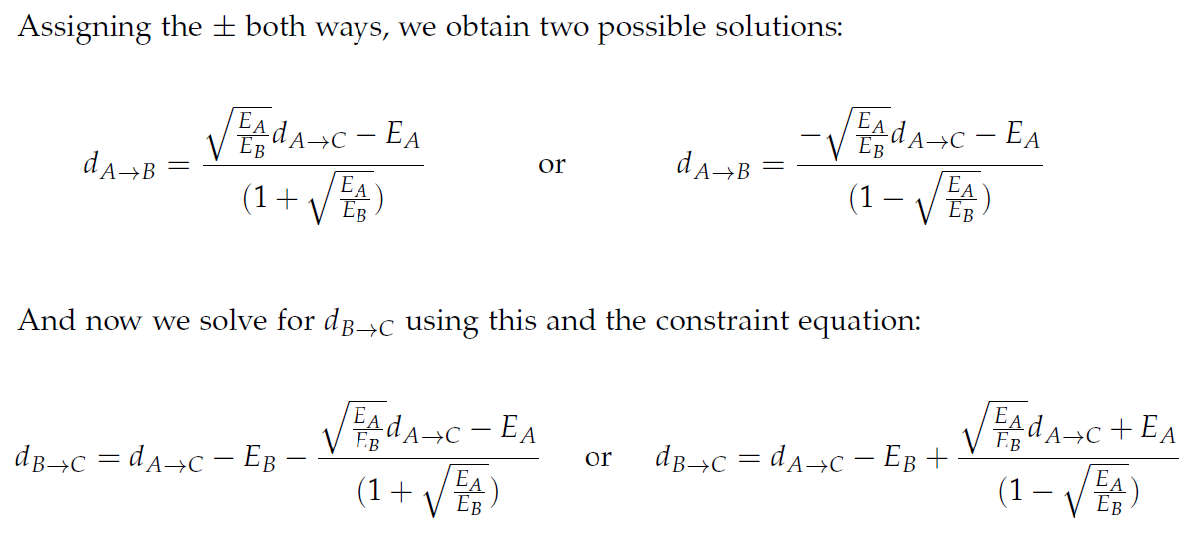
Second point “cheats” by using negative values, discard

Slide 21
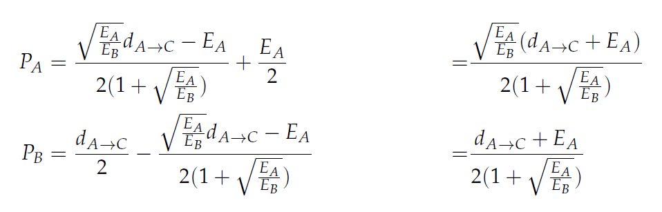
Plug in local constraints to find period assignments

Slide 22
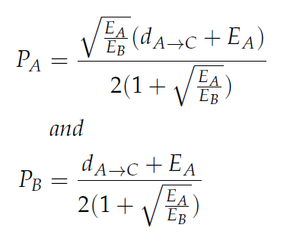
Solution
To ensure the freshness of data from task A to task C, set:

Slide 23
Benefits of this Method
Scheduler agnostic – works for any schedulable system
Simply computed input task periods given freshness constraint
Final consuming task’s period is irrelevant; guarantees freshness for any job placement of the task

Slide 24
Issues with this Method
Scheduler agnostic – doesn’t use scheduler-specific information
Doesn’t guarantee schedulability, must be confirmed afterwards
Doesn’t account for period of consuming process.

Slide 25
Future Work
Can method be generalized to N tasks?
Can we extend to multicore/distributed systems?
Can it be extended with simple assumptions about the scheduler?

Slide 26
Resource Sharing (For Xen)

Slide 27
Summary
Working on implementation and changes/extensions to M-BROE resource sharing protocol
M-BROE extends BROE to multicore system with global resources
Basic idea: “ask” if we can access global resource before budget completion

Slide 28
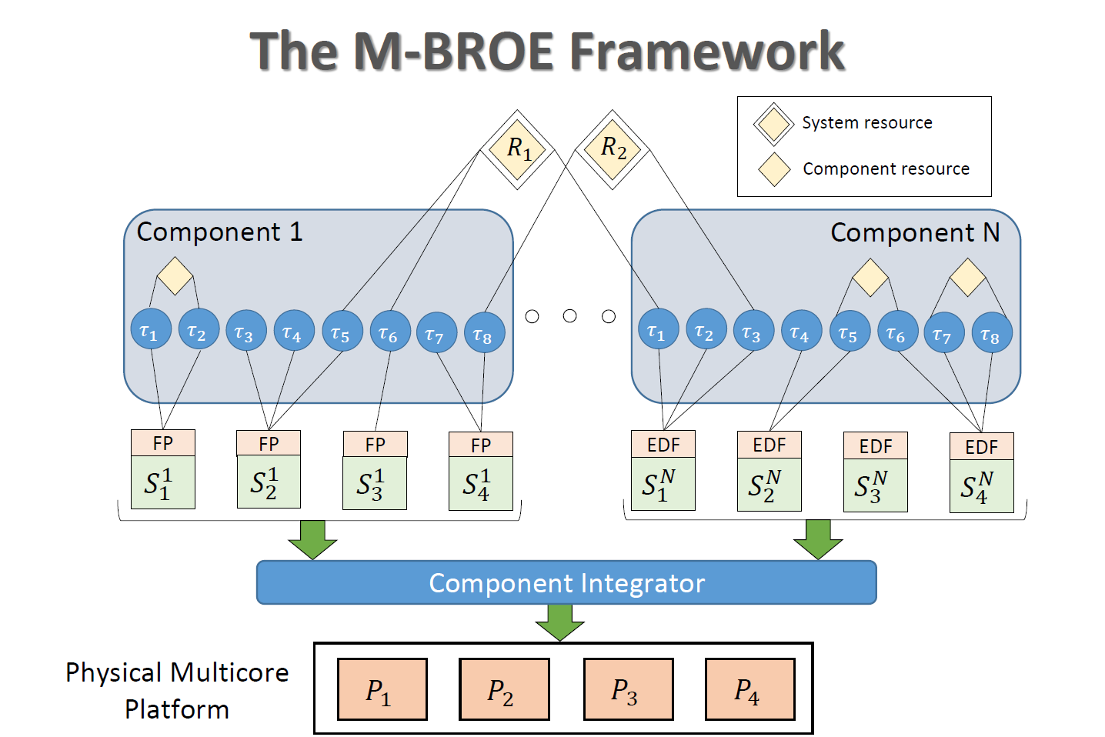
M-BROE Overview

Slide 29
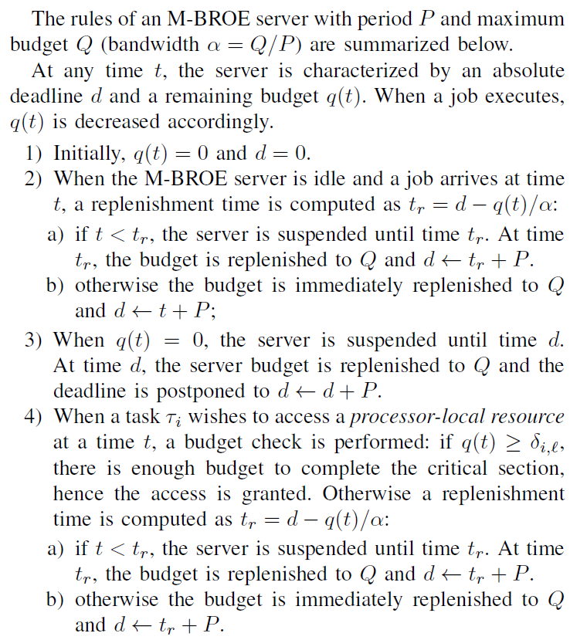
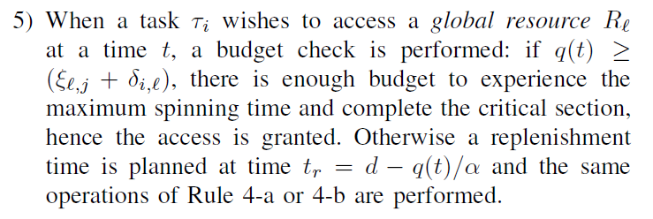
M-BROE Rules
BROE
With This, We Have M-BROE

Slide 30
Towards Implementation / Test Bed
Deterministic Waiting
Formulation utilizes FIFO, non-preemptable spinlocks
Created kernel module to export kernel spinlocks to userspace via a device file
Example Xen resource to develop and test on
Towards completion of a global console that any Xen guest can write to
Future resource of interest: memory [pages]

Slide 31
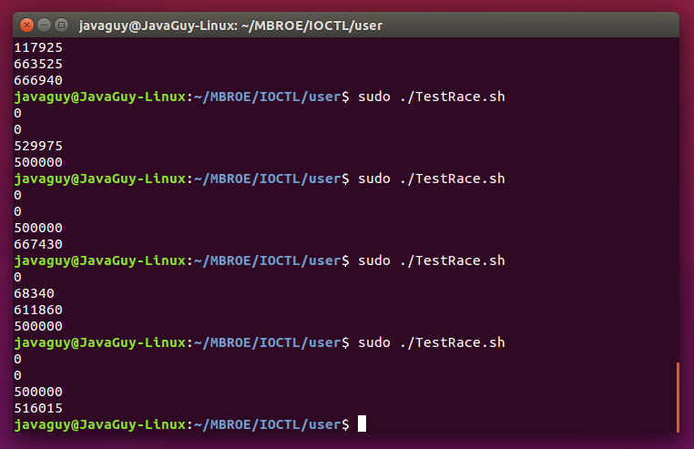
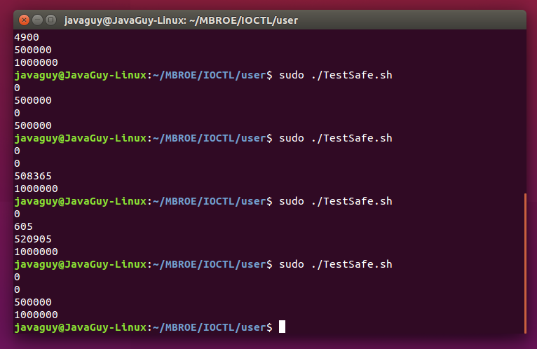
User-Space Accessible FIFO, Non-Preemptable Spinlock

Slide 32
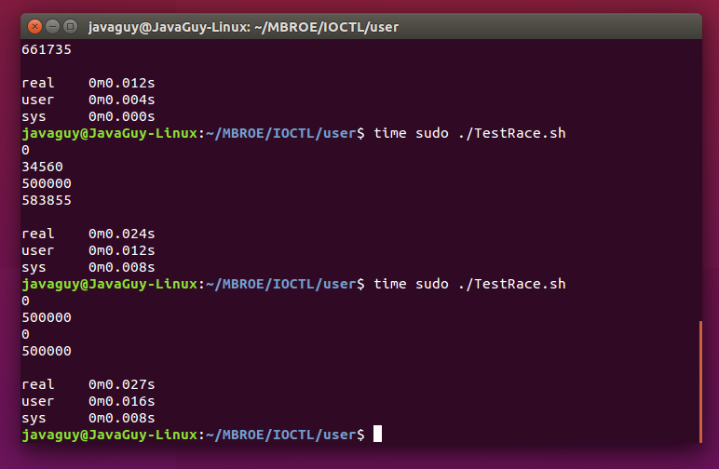
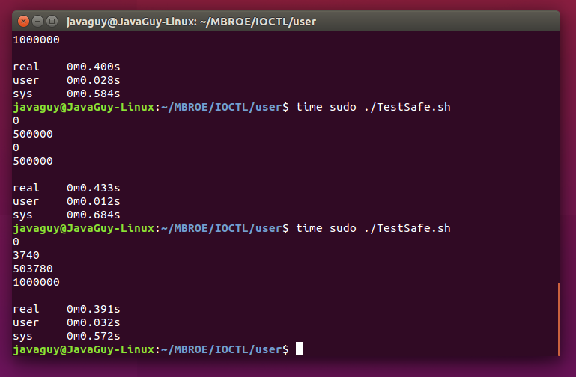
Expected Timing Discrepancy

